Slide 1
Surrogates Update
March 18, 2020

Slide 2
Ecoregion-level Results
Group | Common name | N | Adj-R2 | RMSE
Ungulates | Boreal caribou | 30 | 0.42 (-0.11-0.96) | 0.07 (0.01-0.12)
Songbirds | Blackburnian Warbler | 6 | 0.66 (0.19-0.92) | 0.06 (0.04-0.09)
 | Boreal Chickadee | 48 | 0.47 (0.03-0.89) | 0.09 (0.03-0.14)
 | Brown Creeper | 20 | 0.45 (0.02-0.78) | 0.08 (0.06-0.12)
 | Black-throated Green Warbler | 16 | 0.58 (0.23-0.95) | 0.07 (0.04-0.11)
 | Canada Warbler | 10 | 0.57 (0.24-0.98) | 0.07 (0.02-0.12)
 | Cape May Warbler | 15 | 0.52 (0.02-0.91) | 0.08 (0.05-0.13)
 | Olive-sided Flycatcher | 39 | 0.38 (0.01-0.95) | 0.08 (0.03-0.15)
 | Pine Grosbeak | 48 | 0.48 (0.04-0.97) | 0.07 (0.02-0.14)
 | Rusty Blackbird | 48 | 0.45 (0.01-0.95) | 0.08 (0.03-0.14)
 | Swainson's Thrush | 46 | 0.54 (0.06-0.97) | 0.08 (0.02-0.14)
 | White-winged Crossbill | 48 | 0.44 (0.02-0.91) | 0.08 (0.04-0.14)
 | All forest birds | 48 | 0.44 (-0.00-0.90) | 0.09 (0.04-0.14)
 | All birds | 48 | 0.41 (0.02-0.89) | 0.08 (0.04-0.14)
Waterfowl | Cavity nesting waterfowl | 48 | 0.43 (0.02-0.88) | 0.07 (0.03-0.15)
 | Ground nesting waterfowl | 48 | 0.37 (0.01-0.96) | 0.09 (0.03-0.15)
 | Overwater nesting waterfowl | 48 | 0.39 (0.00-0.97) | 0.08 (0.02-0.14)
 | All waterfowl | 48 | 0.39 (0.01-0.96) | 0.08 (0.02-0.16)

Slide 3
Considerations…
Should we focus on one or two ecozones e.g., Taiga and/or Boreal Plains? Relegate others to supplementary material. This would avoid some of the issues with ecoregions at the edge of species’ range.
Should we focus on one or two songbird species? Relegate others to supplementary material.
Should we consider using generic (model) species that represent, for example, combinations of habitat and density/variability?
Addressing potential criticism:
Using predictive density maps instead of underlying bird survey data: better coverage that is not possible with survey locations
Using predictive density maps as target features rather than as surrogates themselves i.e., why not use the density maps directly in conservation planning?

Slide 4
Test features
Use groups of species (guilds, etc.) not individual species
Purpose of surrogates is to represent multiple features not individual species
Individual species can be represented using density maps
See ABMI groupings, also Diana has some references she will share
Use several metrics
Sum of density
Diversity and evenness
Multivariate: Bray-Curtis, Jaccard, etc.
Evaluate representation for individual species e.g., Caribou

Slide 5
ABMI Bird Guilds
Level 4:
Forest
Grassland/Meadow
Alpine
Peatland
Aquatic/Wetland
Habitat Generalist
Non-Native
Level 3:
Old-growth Forest
Forest Burns
Early Seral
Interior Forest
Forest Edge
Uncommon Species
High Responsibility
Human Modified Habitat
Riparian
Cavity Nester
Habitat Engineer
Irruptive Species
Carnivorous Species
Game Species
Winter Residents
Neotropical Species
Short Distance Migrants

Slide 6
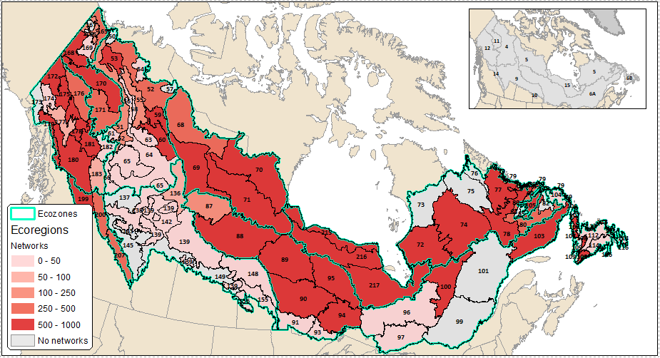
Ecozones
Manuscript:
Taiga Shield (5)
Boreal Shield (6A)
Hudson Plains (15)
Supp Info:
Taiga Plains (4)
Boreal Shield (6B)
Boreal Plains (9)
Taiga Cordillera (11)
Boreal Cordillera (12)
Montane Cordillera (14)

